Slide 1
Analyzing Global Life Expectancy (2010–2021)
Data Engineering Project Presentation

Slide 2
Objective:
To analyze trends in global life expectancy using authoritative WHO data.
Specifically, to identify and visualize the top 10 countries by average life expectancy between 2010 and 2021.

Slide 3
Tools & Technologies Used
Programming Language: Python
Data Source: WHO Global Health Observatory API
Libraries: pandas, numpy, requests
Database: SQLite3 for local, persistent storage
Visualization: matplotlib and seaborn

Slide 4
Data Ingestion Process
Data sourses
https://www.who.int/data/gho/info/gho-odata-api
Provider: World Health Organization (WHO
Dataset: WHOSIS_000001 – Life Expectancy at Birth
Data Format: JSON retrieved via WHO RESTful API
Time Range: 2000 to 2021 (our focus: 2010 to 202

Slide 5
Core Libraries:
requests – handles API calls
pandas, numpy – used for data wrangling and transformation
matplotlib, seaborn – used for data visualization
sqlite3 – handles local data persistence

Slide 6
ETL Pipeline
API_URL = https://ghoapi.azureedge.net/api/WHOSIS_000001
Extraction:
Transformation:
Removed duplicates and rows with null or malformed values
Converted Year and Value columns to numeric types
Filtered the data to only include years 2010 through 2021
Grouped by country and calculated average life expectancy for each

Slide 7
Loading:
Stored processed data into a local SQLite database (life_expectancy.db)
Two main tables created:
life_expectancy: cleaned, yearly value
avg_life_expectancy: per-country average from 2010 to 2021

Slide 8
DATA PIPELINE
A[Raw API Data] --> B[Drop duplicates & NaNs]
B --> C[Convert Year & Value to numeric]
C --> D[Filter for 2010–2021]
D --> E[Group & Aggregate]
E --> F[SQLite Database]

Slide 9
Top 10 Countries by Avg. Life Expectancy (2010–2021)
Top countries: Singapore, Japan, Switzerland, Iceland, Norway, Australia, etc.
Computed average life expectancy for each country over the 12-year wind
Countries are sorted in descending order for visual clarity

Slide 10
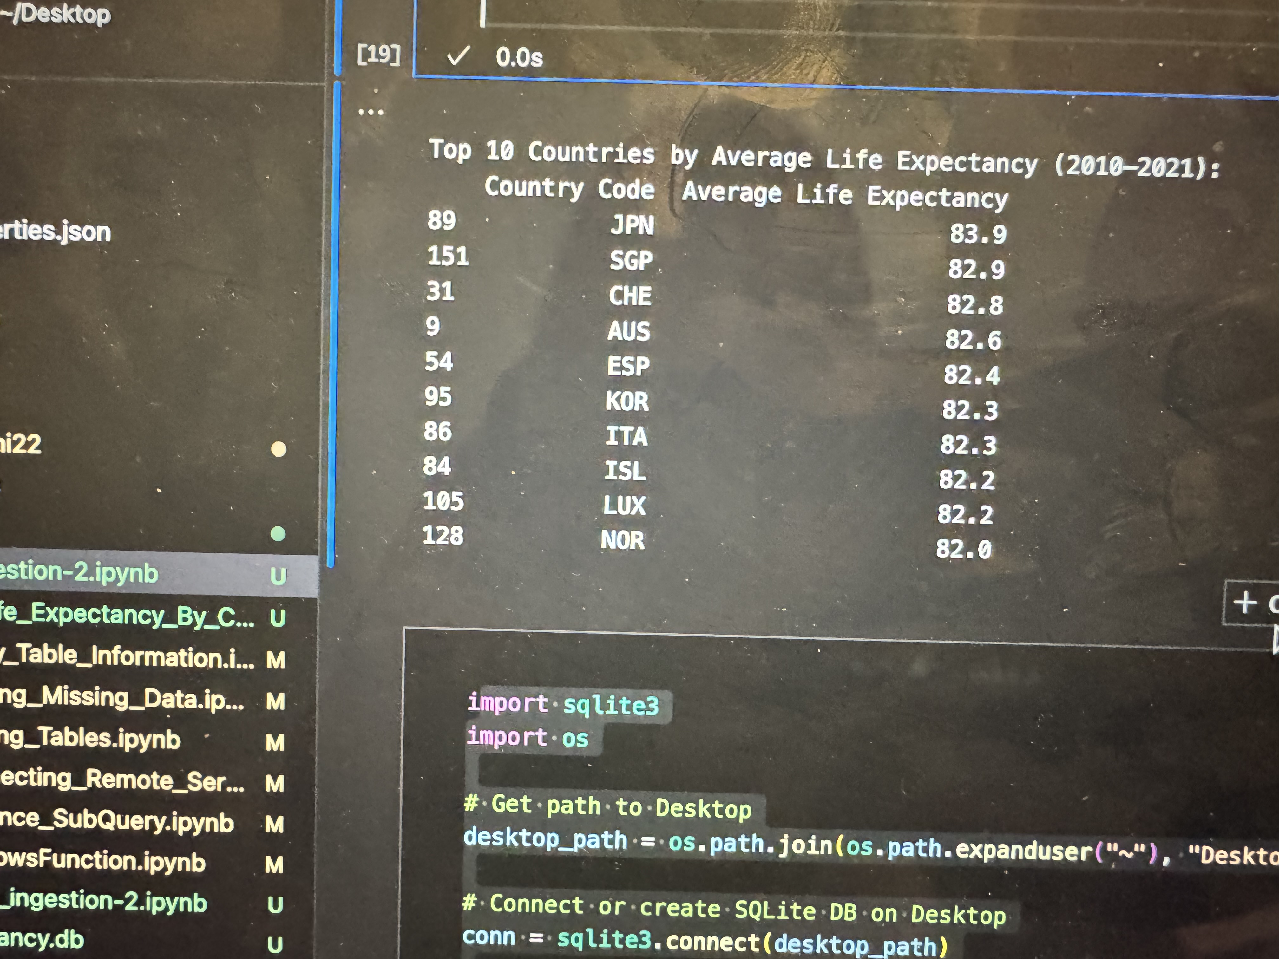
Top 10 Countries by Avg. Life Expectancy (2010–2021)

Slide 11
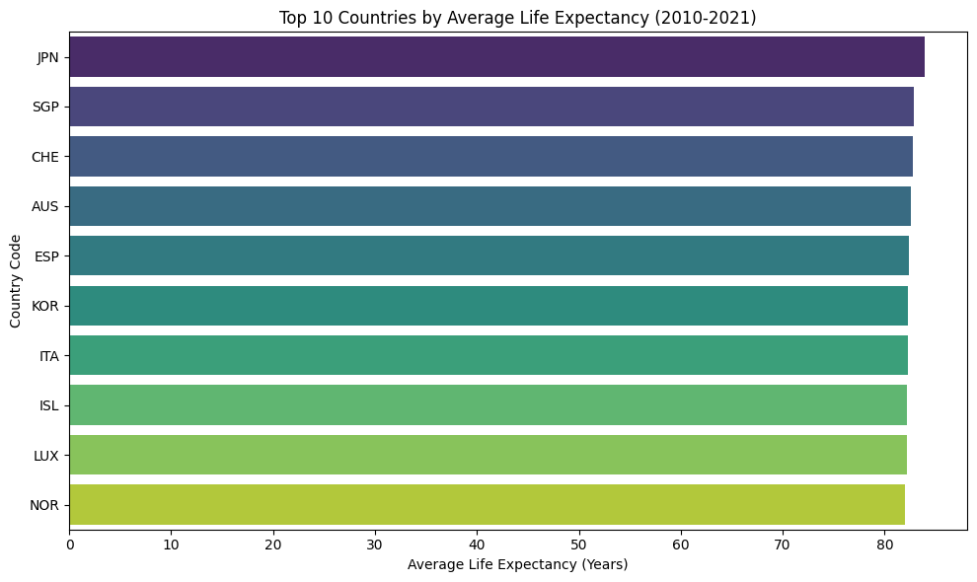
Top 10 Countries by Avg. Life Expectancy (2010–2021)

Slide 12
Ethical Considerations
Privacy no personal data used all data is public and anonymized
Transparency:
Assumption and sourse code are well documented
Public who Api linked for reproducibility

Slide 13
Challenges soulation
Missing / malformed values | Used dropna() and pd.to_numeric()
Inconsistent API structure | Built flexible JSON key handling logic
Data too large for in-memory | Used SQLite for partial loading and filtering
Uneven data availability | Aggregated only countries with full 12-year records

